Slide 1
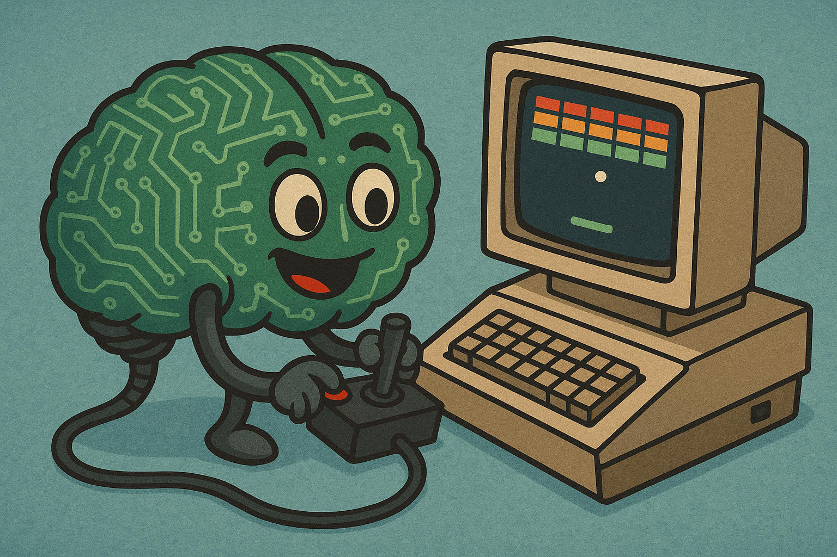
Playing Atari with Deep Q-Learning
CS747 Final Project
Russell Bisker

Slide 2
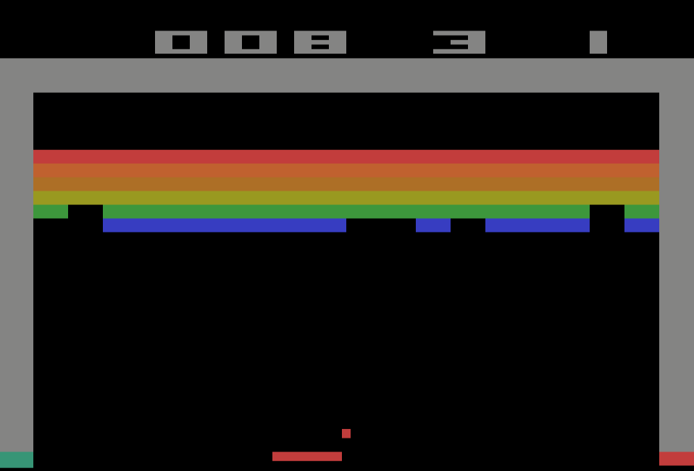
Goals & Tools
Goals
Tools & Frameworks
Implement DQN & DDQN networks similar to those described in seminal papers
Focus on training agent to play Breakout, a simple Atari game with limited action set (FIRE, LEFT, RIGHT, NOOP). Agent is trained only on the latter 3 (not FIRE)
Attempt to improve on results using various techniques (modified NN architectures, optical flow, PER, etc)
Used OpenAI Gymnasium and Arcade Learning Environment, python frameworks which emulate Atari 2600 games in an interactive, programmable manner

Slide 3

Deep Q-Learning (DQN) Overview
The Bellman Equation (traditional Q-Learning)
$$Q^{∗}\left(s,a\right)=E_{s^{′}}\left[r+γ\max_{a^{′}}{Q^{∗}}\left(s^{′},a^{′}\right) ∣ s,a\right]$$
In English: the Q-value of choosing action a at the current state s is equal to the immediate reward r plus the discounted value of the best future Q-value from the next state s′ assuming the agent follows optimal policy going forward
How does Deep Learning factor in?
For even moderately complex games, the state space, action space, or both can be far too large to compute Q-values analytically . So, we’ll use a neural network to attempt to learn the Q function.
The Basic Building Blocks
2 Neural Networks, Policy and Target, each initialized to the same weights
A Replay Buffer, which contains hundreds of thousands of entries, each w/ game screen, action taken, reward received, and a “life lost”-flag. Initially this buffer can be generated by having a naïve agent play randomly.

Slide 4
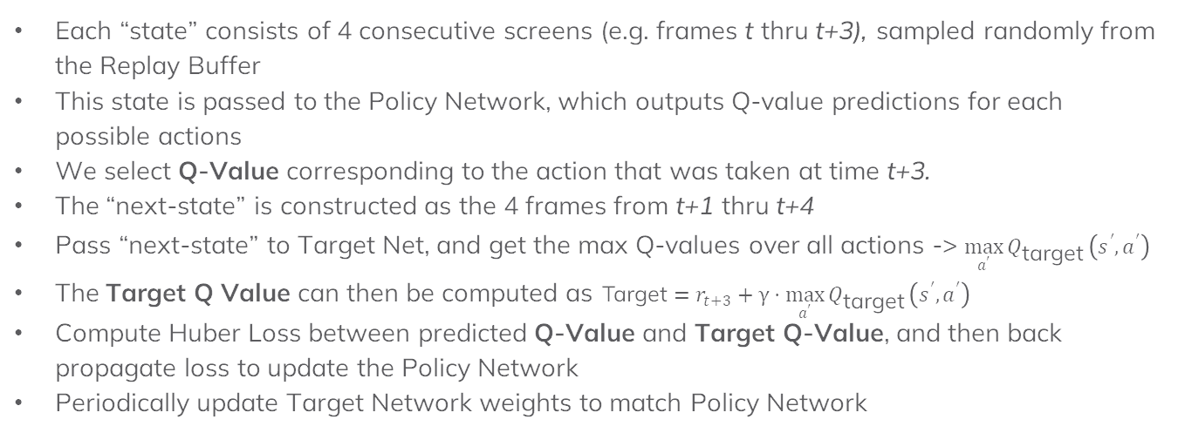
Standard DQN
Each “state” consists of 4 consecutive screens (e.g. frames t thru t+3), sampled randomly from the Replay Buffer
This state is passed to the Policy Network, which outputs Q-value predictions for each possible actions
We select Q-Value corresponding to the action that was taken at time t+3.
The “next-state” is constructed as the 4 frames from t+1 thru t+4
Pass “next-state” to Target Net, and get the max Q-values over all actions -> $\max_{a^{′}}{Q_{\text{target}}}\left(s^{′},a^{′}\right)$
The Target Q Value can then be computed as $\text{Target}=r_{t+3}+γ⋅\max_{a^{′}}{Q_{\text{target}}}\left(s^{′},a^{′}\right)$
Compute Huber Loss between predicted Q-Value and Target Q-Value, and then back propagate loss to update the Policy Network
Periodically update Target Network weights to match Policy Network
State
…
…
Replay Buffer
`
t
t + 1
t + 2
t + 3
t + 3
Next State
Action

Slide 5
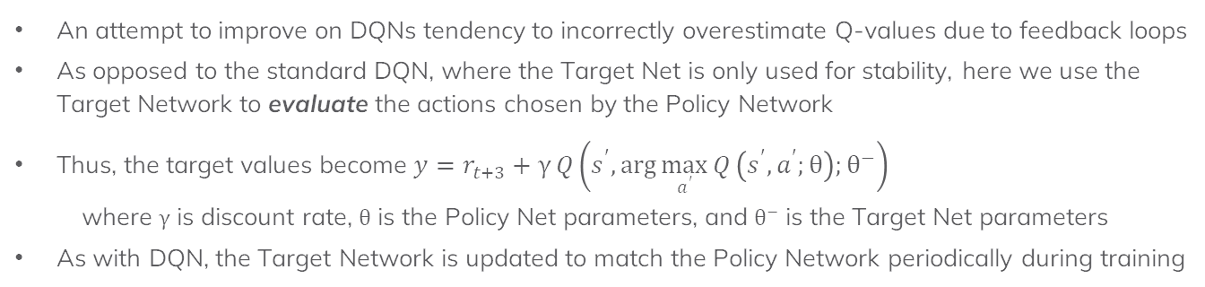
Double DQN (DDQN)
An attempt to improve on DQNs tendency to incorrectly overestimate Q-values due to feedback loops
As opposed to the standard DQN, where the Target Net is only used for stability, here we use the Target Network to evaluate the actions chosen by the Policy Network
Thus, the target values become $y=r_{t+3}+γ Q\left(s^{′},\arg{\max_{a^{′}}{Q}}\left(s^{′},a^{′};θ\right);θ^{−}\right)$
where $γ$ is discount rate, $θ$ is the Policy Net parameters, and $θ^{−}$ is the Target Net parameters
As with DQN, the Target Network is updated to match the Policy Network periodically during training

Slide 6
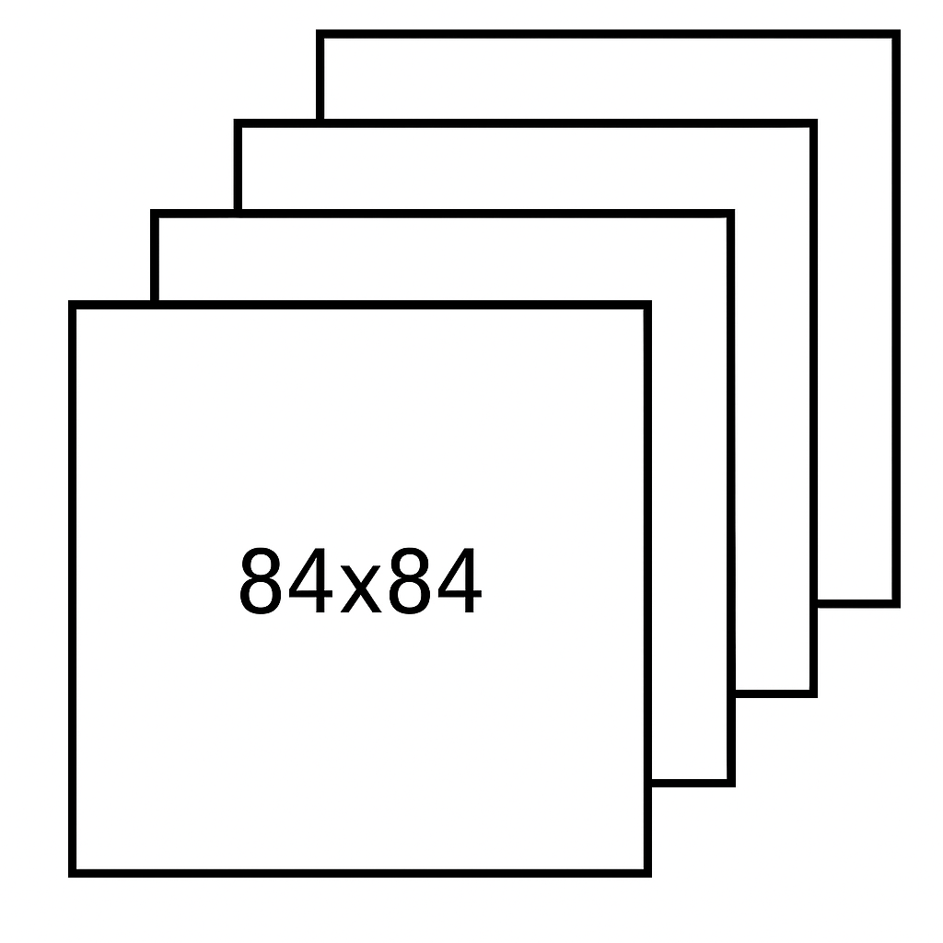
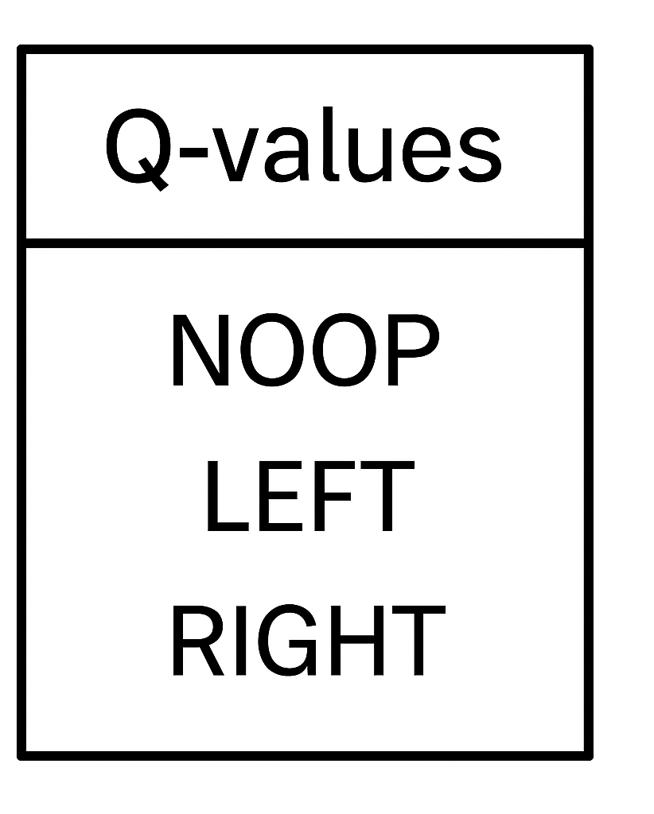

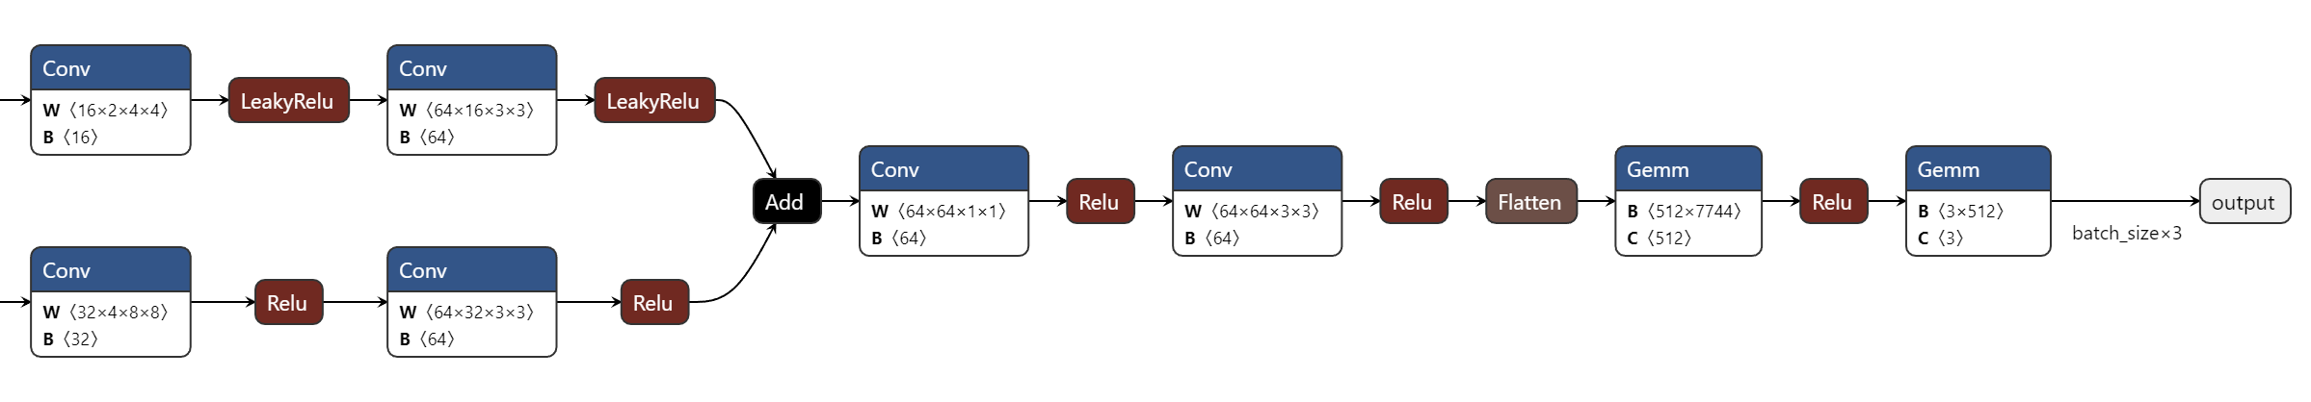
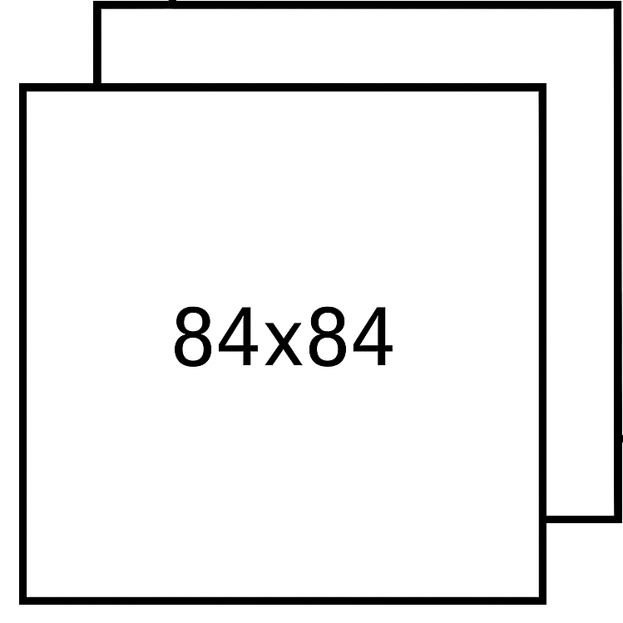
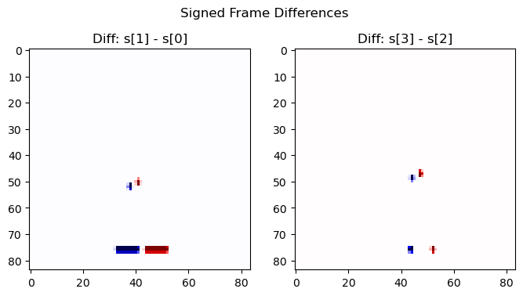
Network Architectures
Basic Network Architecture (similar to papers)
Attempted Improvement – Input Full Frames and Diff Frames (to track motion)
Full Frames
Diff Frames
Example of what diff frames look like

Slide 7

Training Montage
YouTube Link: https://youtube.com/shorts/uEfbaV17R18

Slide 8
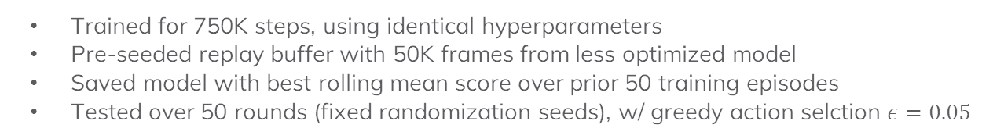
Testing & Results
Testing Procedure
Trained for 750K steps, using identical hyperparameters
Pre-seeded replay buffer with 50K frames from less optimized model
Saved model with best rolling mean score over prior 50 training episodes
Tested over 50 rounds (fixed randomization seeds), w/ greedy action selction $ε=0.05$
Model Description | 50 Rounds (5 Lives ea.)
 | Mean Score | Std Dev
Std DQN, Basic Network Arch | 23.7 | 4.94
DDQN, Basic Network Arch | 10.2 | 2.80
Std DQN, Branched Network, Cropped Frames (to remove scoreboard) | 15.3 | 3.63

Slide 9
Conclusions & Other Things I Tried
Conclusions
Testing different setups was difficult due to time consuming runs ~6-8hrs or more
Was surprised DDQN didn’t perform better, as it should according to literature. May have needed tweaked hyperparameters, or simply longer training, as it is in theory more conservative, especially early in training (I saw this in my results)
Also surprised incorporating diff frames didn’t help, but again, may be due to sub-optimal branched network architecture and/or sparsity of diff images (majority of screen is static besides ball and paddle)
Some of the Additional Modifications Experimented With
Priority Experience Replay (PER)
Tracks and selects higher loss states in Replay Buffer and selects them with higher probability
Optical Flow inputs into the branched model instead of diffs -> library I used didn’t work bc not enough movement between frames
Parallelized game environments in training -> didn’t actually increase speed bc all envs used same network model and forward pass was main speed bottleneck

